Slide 1
Satellite Imagery
Aerial Imagery
Sentinel-1 C-Band Synthetic Aperture Radar (SAR)
Sentinel-2 Multispectral Instrument (MSI) Level 2A
National Agricultural Imagery Program (NAIP)
Pre-processing
Pre-processing
Training Data
Metadata filters
Metadata filters
Quaking Aspen Mask (USFS ITSP & TreeMap)
Winter stack (Dec-Feb)
Summer stack (June-Aug)
Summer stack (June-Aug)
Autumn stack (Sept-Nov)
Random sample 1000 plot centers within aspen mask
Additional border noise correction
Label aspen pixels by analyst using NAIP imagery
Cloud and cloud shadow masking
Multi-temporal speckle filtering
Calculate spectral vegetation indices
Background reference data:
Stratified sample of LANDFIRE EVT
Combine orbital passes for both polarizations
Input Image Stack
Sentinel-1 Inputs
Sentinel-2 Inputs
Sampled Presence / Background Reference Data
Median summer/winter VV, VH composites and GLCM texture features
Median summer/autumn spectral composites and vegetation indices
Classification and Accuracy Assessment
Model tuning and feature selection (sensitivity)
Random Forest Classifier SBCV and 10 folds (run for each combination of band inputs)
Accuracy and Selection of best model
Remove highly correlated bands
Final model
Feature importance and accuracy
Map of quaking aspen forest cover at 10-meter spatial resolution
Spatial agreement and landscape patch analysis

Slide 2
Satellite Data
Sentinel-1 GRD C-Band SAR
NAIP / Google Basemap Imagery
Sentinel-2 Multispectral Instrument Level-2A
Metadata filters
Quaking Aspen Mask (USFS ITSP & TreeMap)
Metadata filters
Additional border noise correction
Random sample 1000 points
Summer
Sentinel-1 Pre-processing
Presence and Background Preparation
Autumn
Sentinel-2 Pre-processing
Multi-temporal speckle filtering
Labeling of aspen pixels by analyst using NAIP and Google Basemap
Cloud and cloud shadow masking
Combine orbital passes for both polarizations
Background Points:
Stratified sample from LANDFIRE EVT (c. 2016)
Calculate spectral vegetation indices
Median VV, VH composites
Median spectral composites (Summer & Autumn)
Sentinel-1 Inputs
GLCM texture features
Sentinel-2 Inputs
Classification Image Stack
Sample Presence / Background Reference Data
Remove Highly Correlated Variables
Accuracy Assessment
Model Tuning
Random Forest Classifier
Map of Quaking Aspen Forest Cover

Slide 3
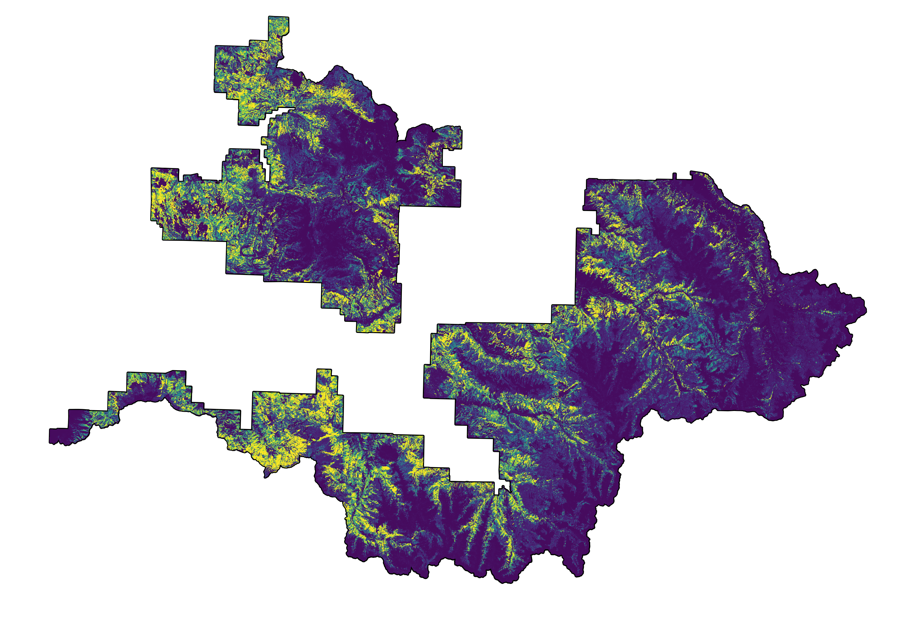
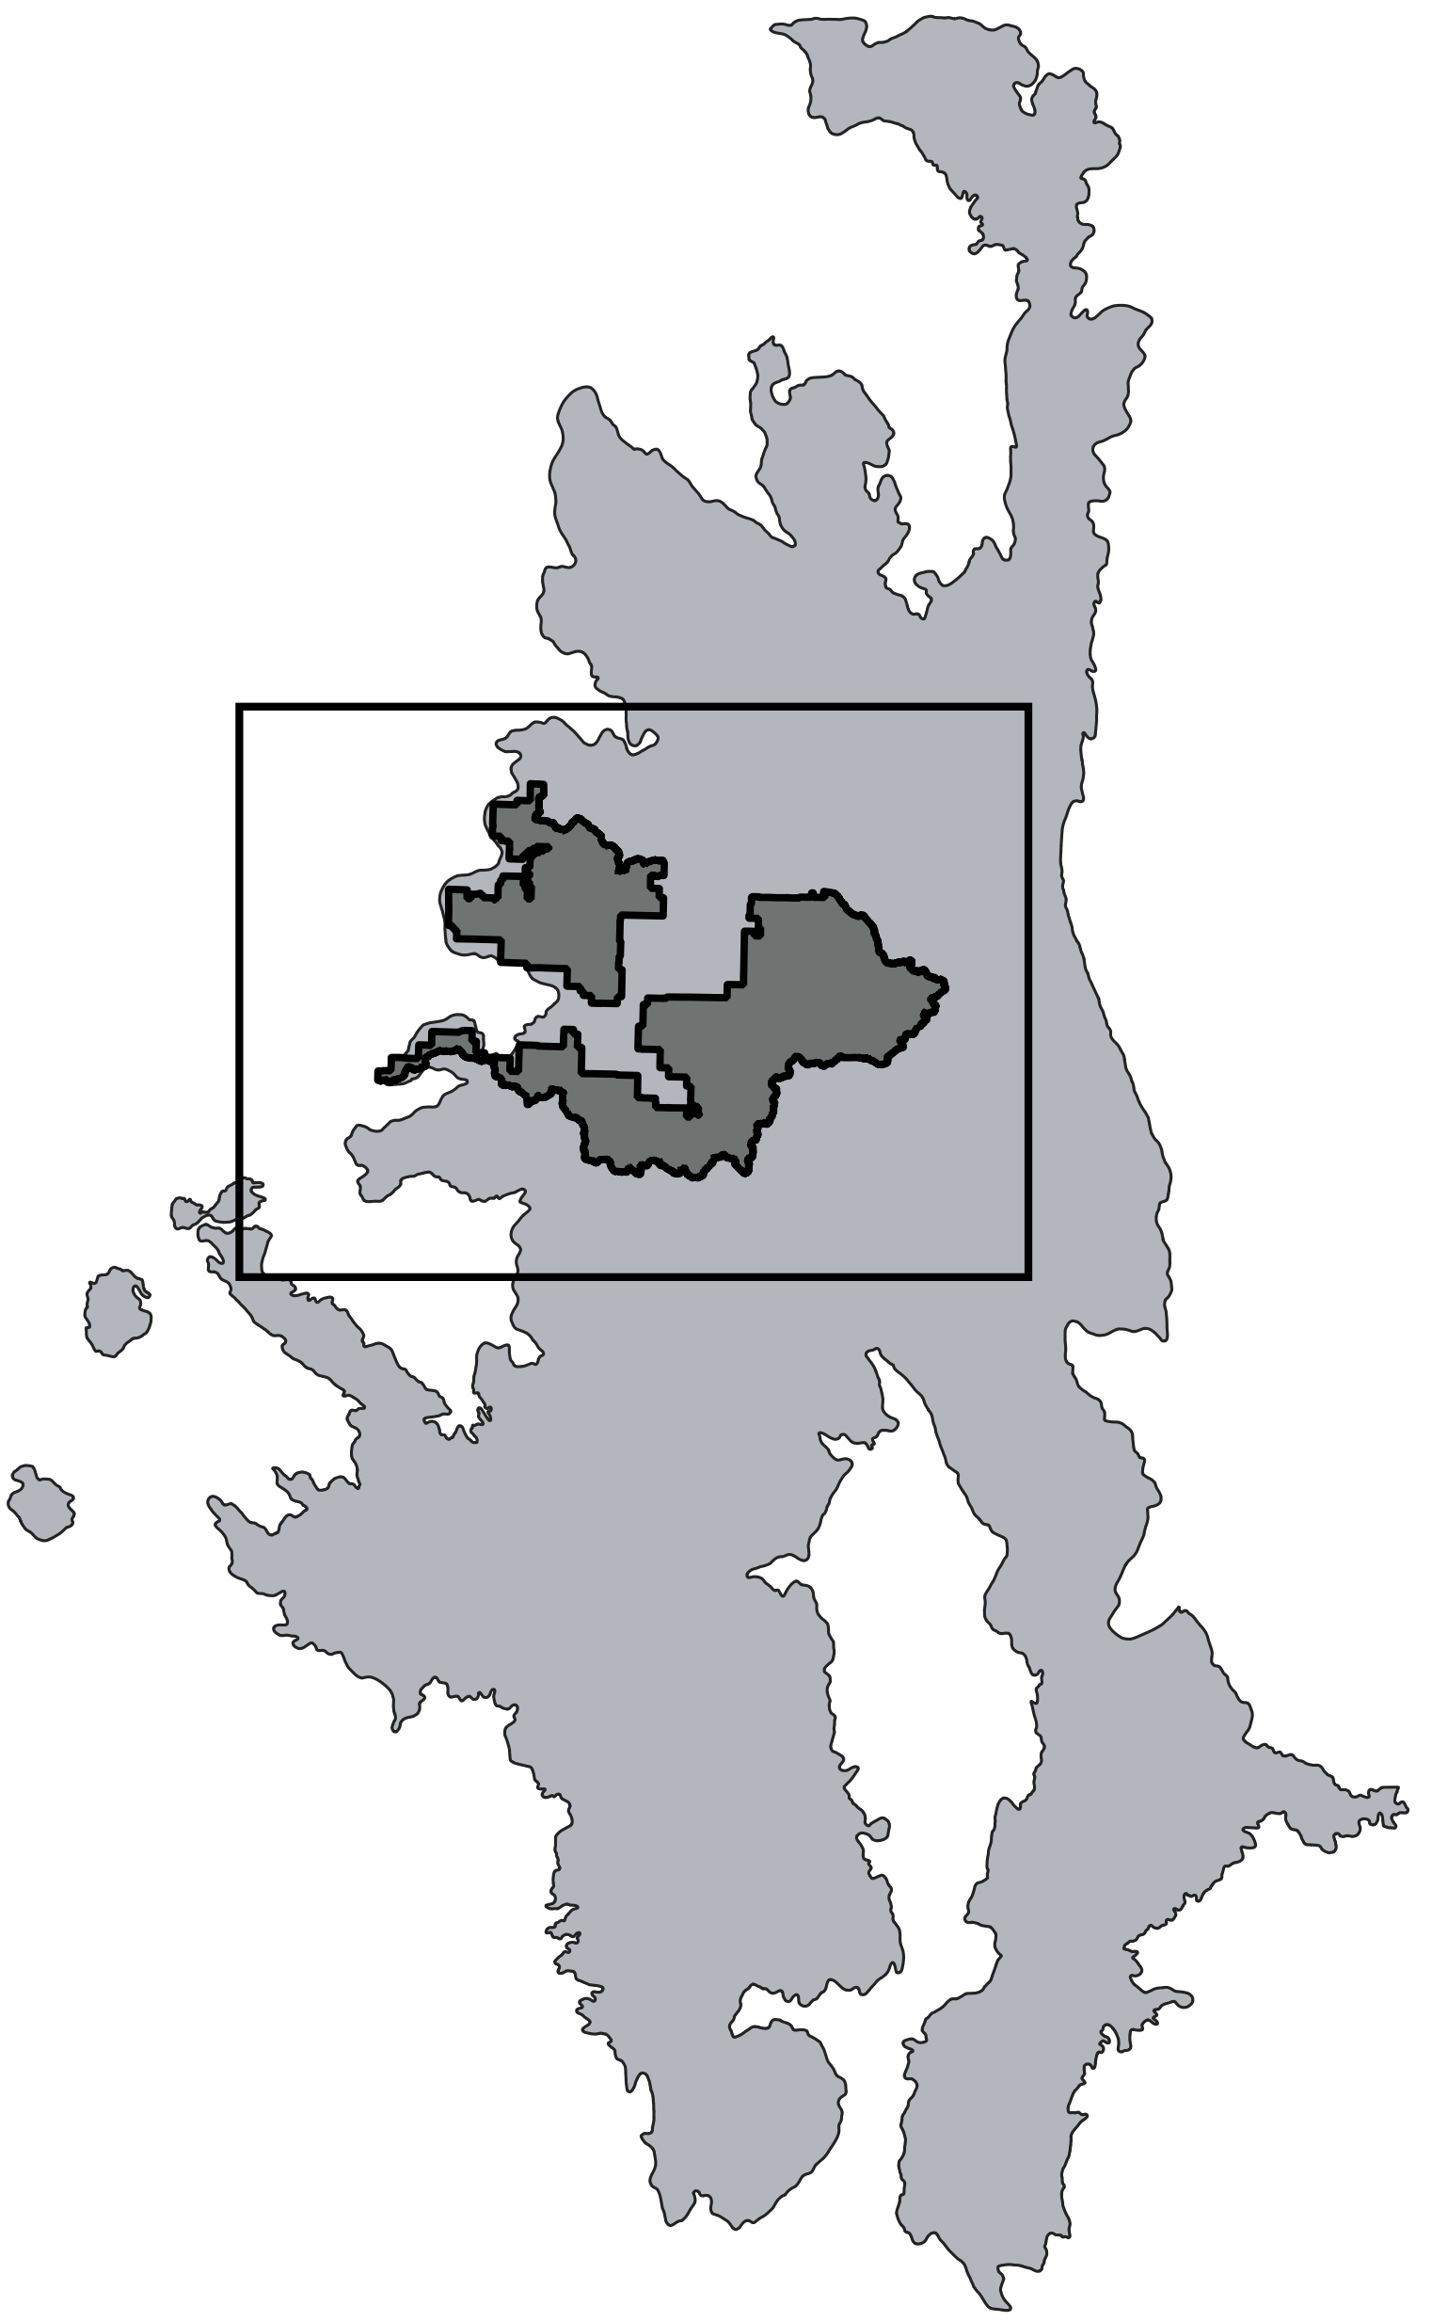
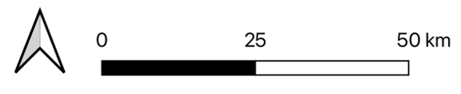

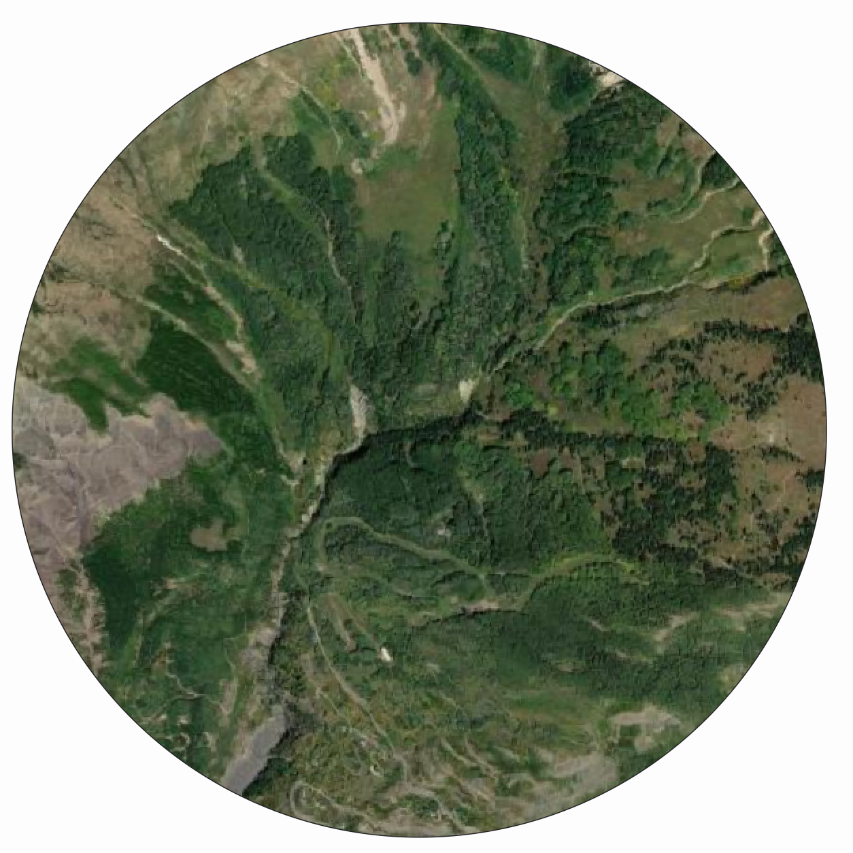
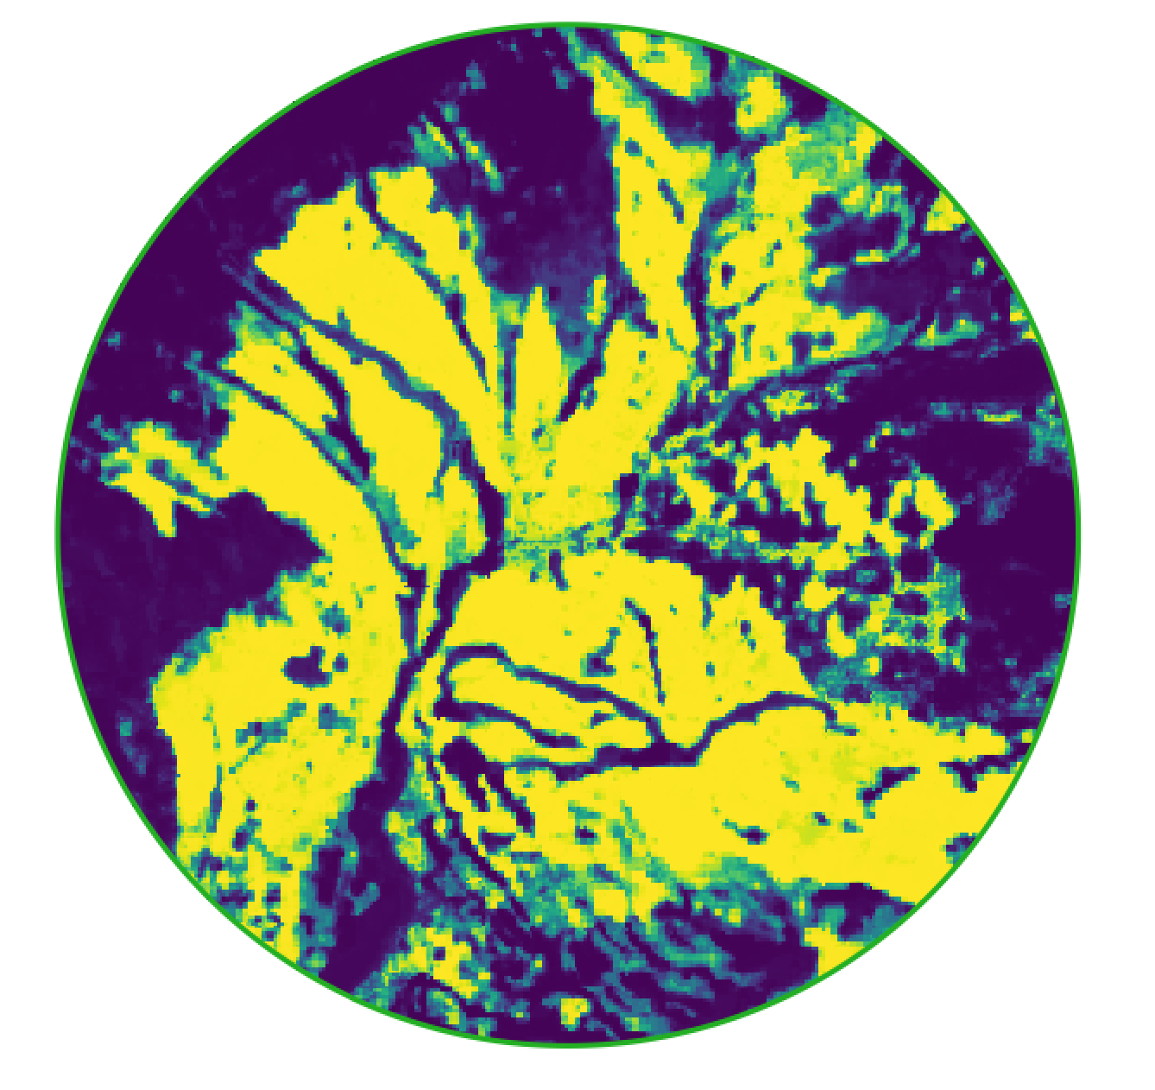
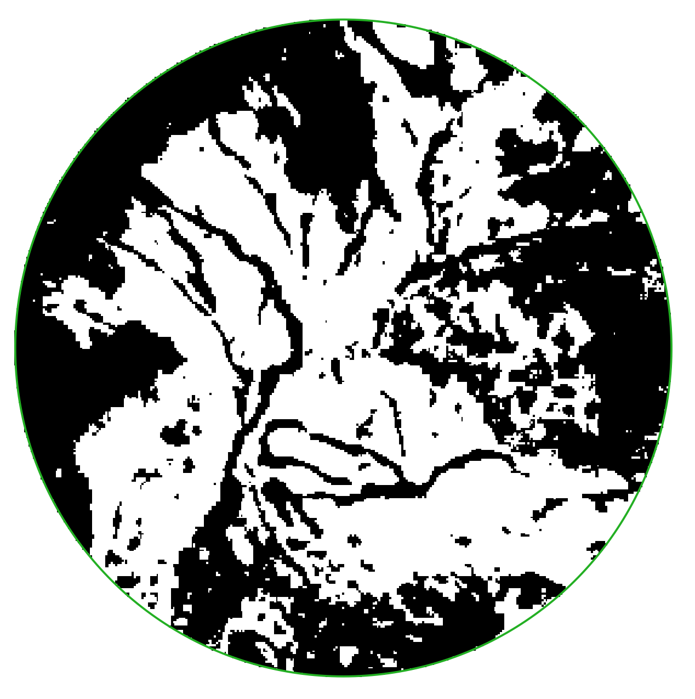
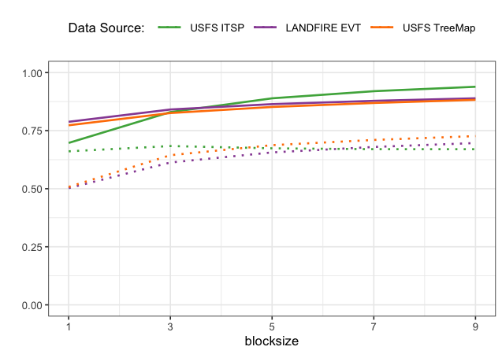
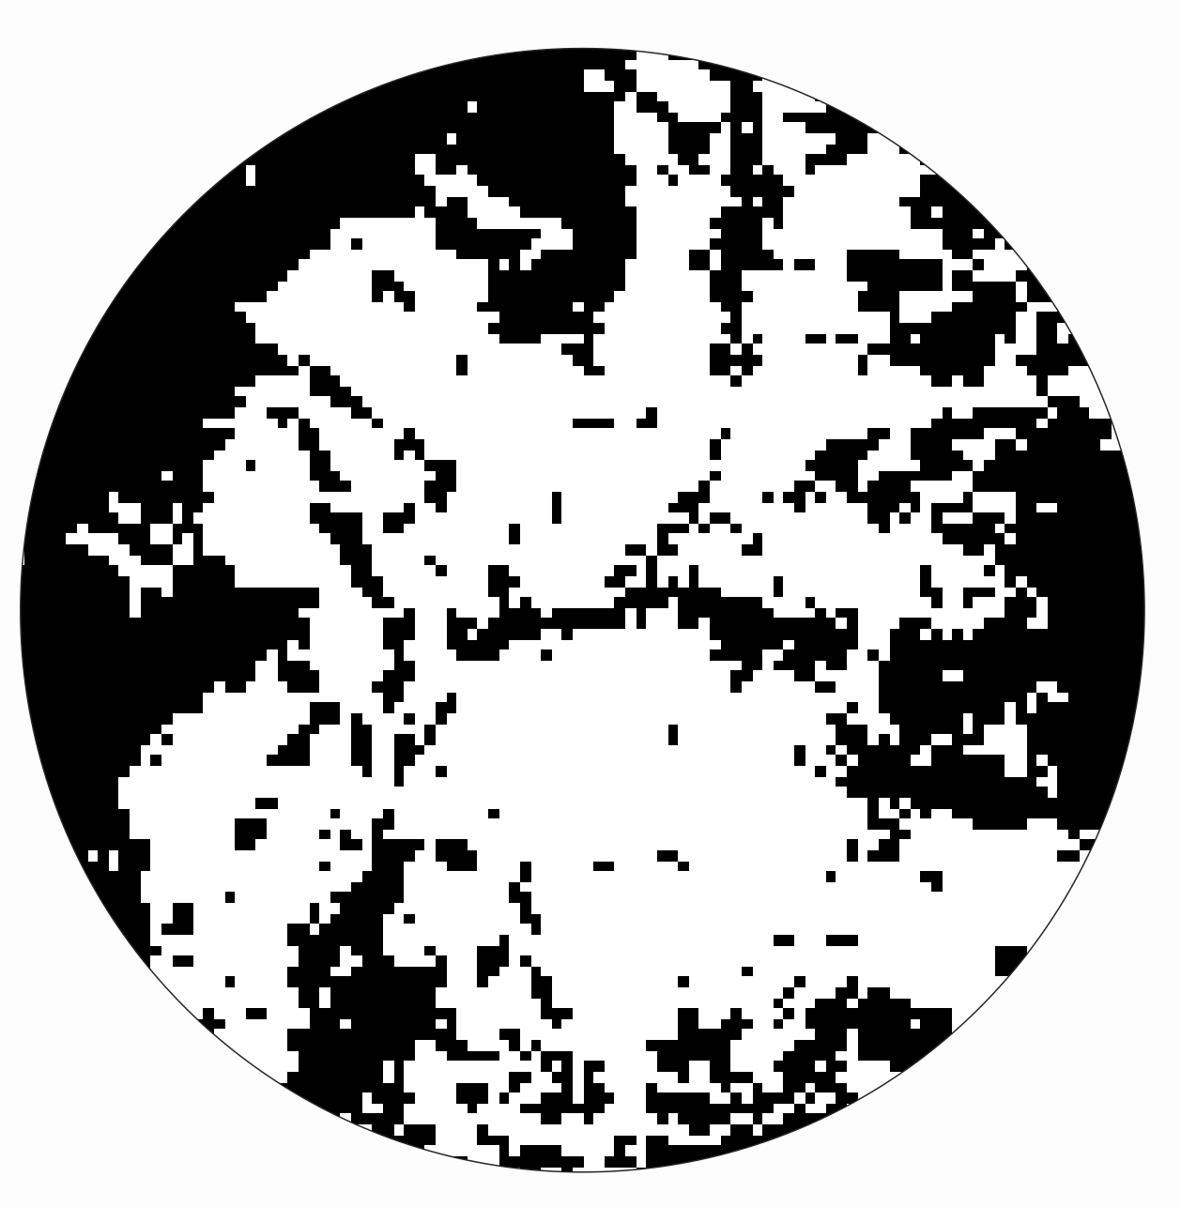
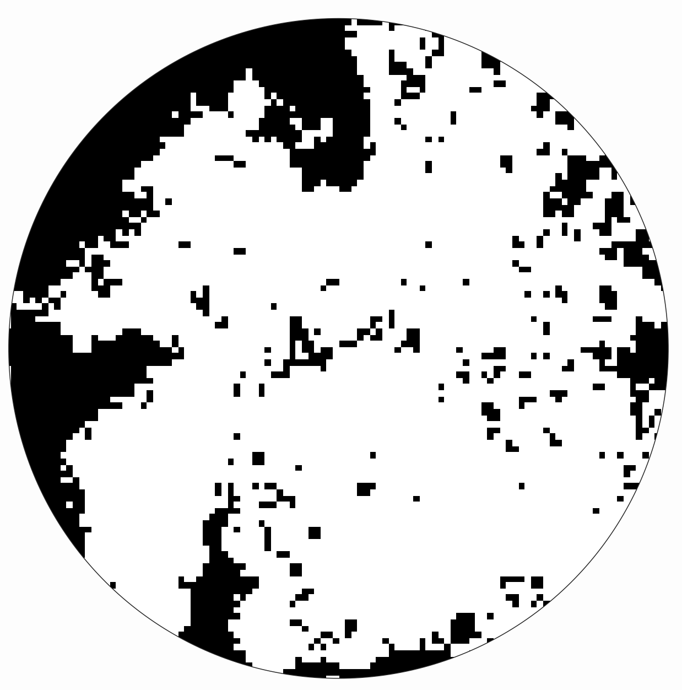

A
H
Quaking Aspen Probability
Low
High
B
C
D
H
E
F
G

Slide 4
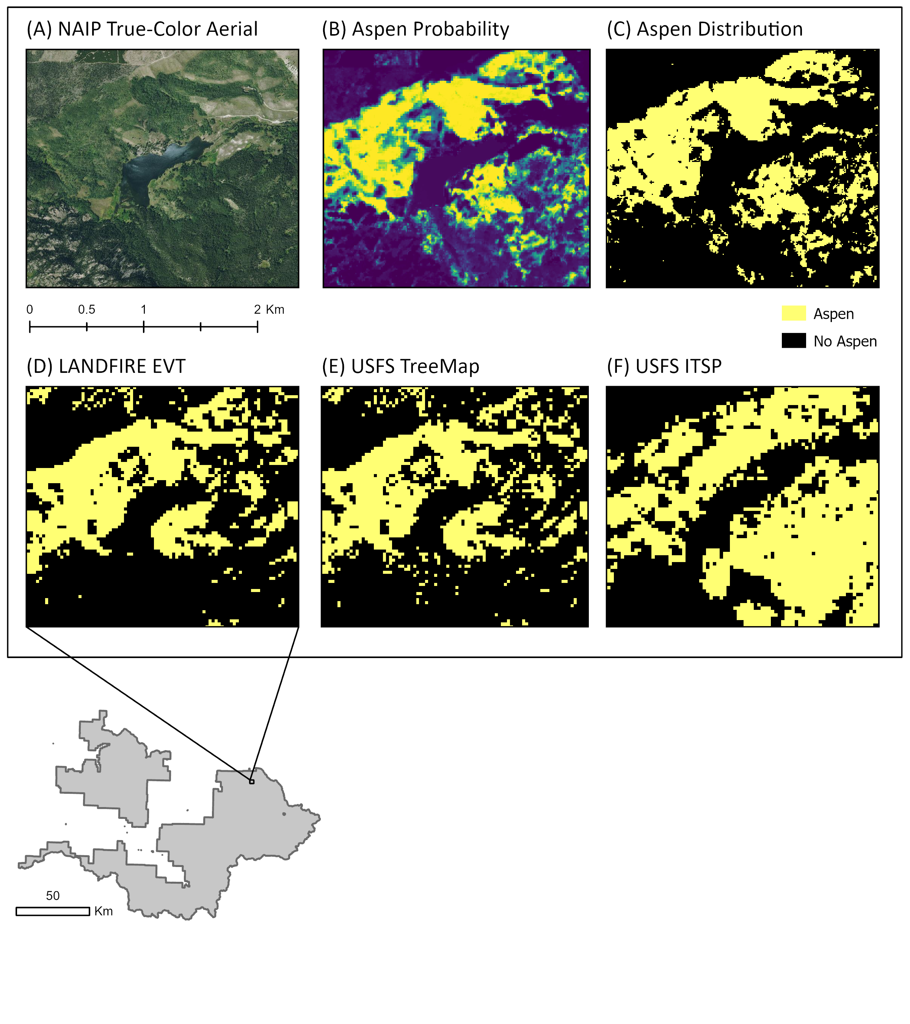
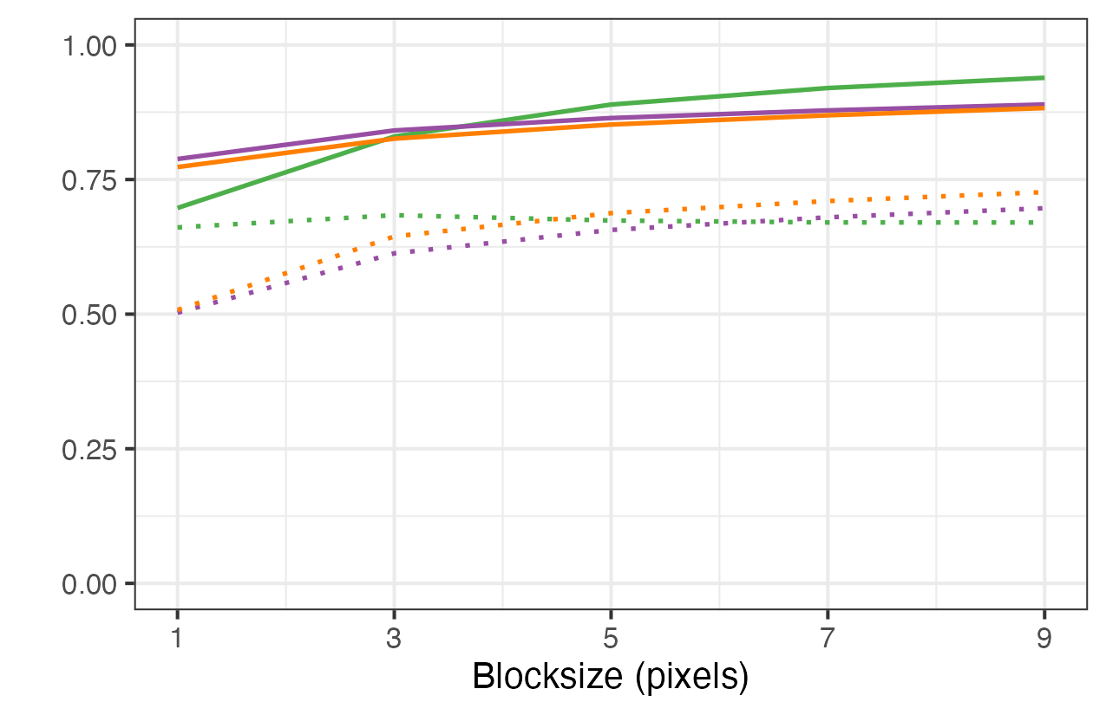
(G)

Slide 5
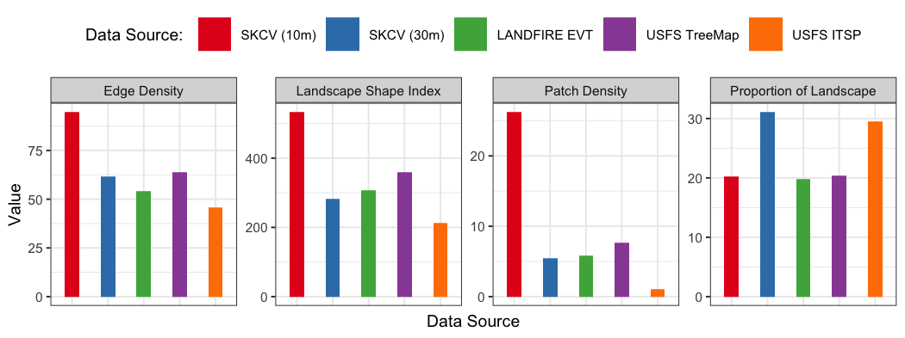
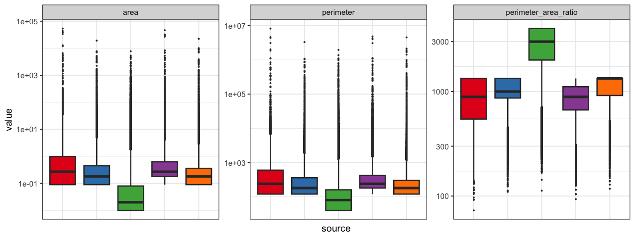

Slide 6
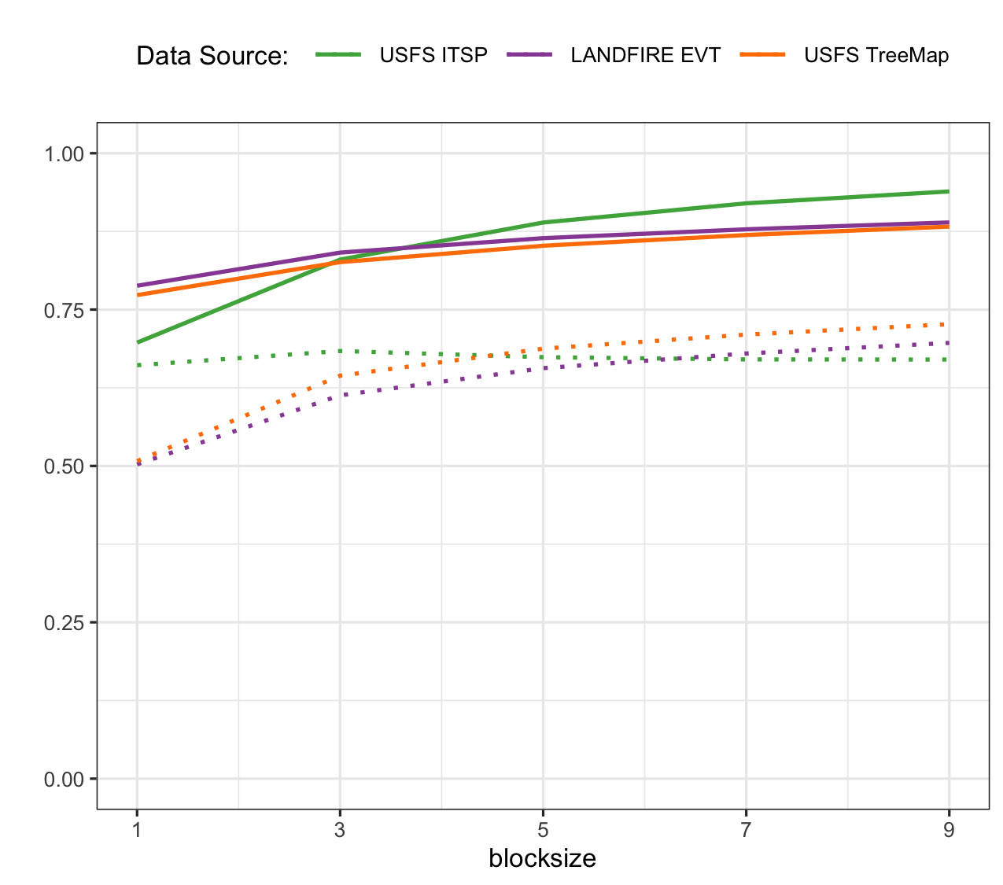
A
Quaking Aspen Probability
Low
High
B
C
D
H
E
F
G
I

